Slide 1
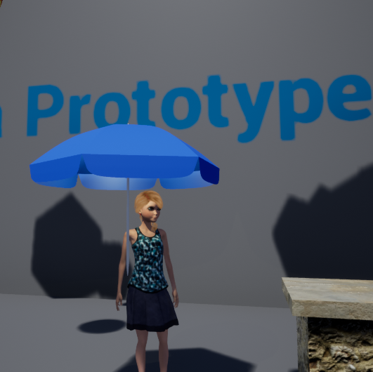
Umbrella
Group
18
Adam Speers
Anastazia Hunt
Fabian mazurek
Declan Grady

Slide 2





The Brief Response
Umbrella – A terrible storm has swept across the land (London) sucking up all the local wildlife “it’s raining Cats and Dogs”. Head out with your trusty umbrella and try to rescue the animals as they fall back down to earth. But be careful to avoid the debris, other things were sucked up too…
Genre
Key Mechanic
Emotions
Key Design Problems
Programming Issues
Side Scrolling Shooter / Platformer
Shooting will be replaced with Reflecting
Focus - Easy Fun – Curiosity, Creativity and Exploration
Hard Fun – Fiero
Serious Fun - Collection
‘KISHOTENKETSU’
Introduce Concept
Develop
Twist
Mastery
Difficulty with reflecting mechanic on umbrella.

Slide 3



Mechanics
We have chosen to use a refelction mechanic to replace shooting as our key mechanic.
The other core mechanics will be avoiding and collecting.
Reflect
Avoid
Collect
The player uses the umbrella to reflect bad projectiles back into clouds. After ‘X’ amount hits a cloud it will disperse, granting a reward.
Bad projectiles reduce player health on contact.
Save all the animals that have been swept up by the storm, can you find them all? Animals will be logged in Journal. Collect health pick ups to keep going.

Slide 4
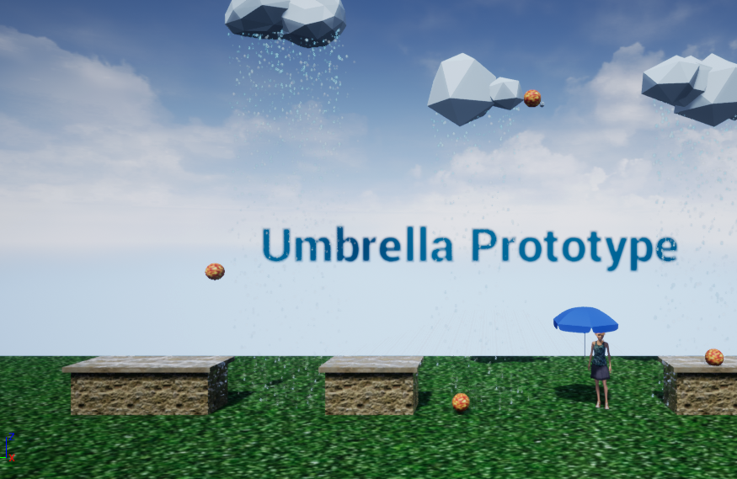
Gameplay Video
Reflect
Avoid
Collect

Slide 5




Next steps
Reward Schedules
High Score Table
Stretch Goal – Animal Journal, rewards for each section.
Power Up – Umbrella 1-up
Boots – Increased Health
Players will be able to see how well they fare against others
The finished game will have these features
Platform Types
Developing Mechanics
Solid – Safe
Grid – Unsafe

Slide 6



Next steps Cont.
Art Assets
Level Timer
Looping backgrounds
Platforms
Collectibles
A time limit for each level (Dramatic tension)
The finished game will have these features
Scoring System
Multiple Levels
On screen score breakdown at end of level to show player how they have done (How they can improve)
Target is to have 3 complete levels

Slide 7
Summary
We feel this concept answers the brief
  Innovative reflecting mechanic in the form of an umbrella. Replacing shooting.
  Other elements of design fit in with the rain / umbrella theme
It only happens when it rains.

Slide 8
Thank You
ANY QUESTIONS?

Slide 9
References
Kishōtenketsu –Phillips, T., 2015. https://www.eurogamer.net/articles/2015-03-17-how-nintendos-best-mario-levels-were-structured-using-chinese-poetry
Timer - Palmer, J., 2015. Https://www.gamasutra.com/blogs/JackPalmer/20151019/256526/Time_for_a_timer__Effective_use_of_timers_in_game_design.php
Raining Animals - https://www.smithsonianmag.com/science-nature/strange-rain-why-fish-frogs-and-golf-balls-fall-skies-180956527/

